Slide 1
Wild Horse and Burro Program
Overview of The Problem:
Current funding of about $37 million can’t continue to support needed wild horse gather operations to maintain an ecological balance on public rangelands and provide lifetime feed and care for 30,000 horses in holding
No additional gathers are possible in FY2008 & FY2009
Budget shortfalls are caused by large numbers of unadopted animals in holding and escalating feed and fuel costs.

Slide 3
History:
In 2001 BLM began an initiative to achieve appropriate management levels on the range.
Since 2001:
-about $214 million have been spent to:
remove 77,000 wild horses and burros from public lands
adopt 44,000
care for the 32,000 horses that were not adopted and are currently in BLM holding facilities
BLM holding facilities are full, and a horse lives 30+ years (In the wild only a small percentage are over 15 years old).
Holding cost in FY2008 will be over $26 million.
This cost will increase annually.

Slide 4
Current National Situation
Appropriate management level is 27,200.
Estimated on-the-Range Population is 33,000
The 2008 population estimate is more than 4,500 animals higher than the BLM estimated in 2007.

Slide 5
Historical Wild Horse and Burro Populations

Slide 6
BLM’s Options are Limited
Stop nearly all Wild Horses and Burro Gathers
Fully Fund Gathering and Lifetime Holding
Consider Sale and Euthanasia of Excess Horses for Which No Adoption Demand Exists

Slide 7
Option 1: Stop Gathering
Horse numbers would double in 4 years from 33,000 to 66,000
Severe environmental consequences would occur as horse populations exceed capacity of their habitat.
Destruction of vegetation & wildlife habitat, soil erosion, and invasive species would spread
Horses would begin to die from starvation
Other public land users affected, livestock would have to be removed

Slide 8
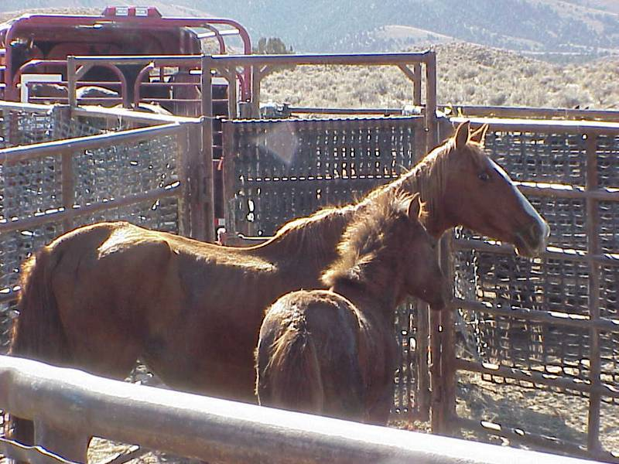
Jackson Mountain, NV Horses suffering from malnutrition due to overpopulation and lack of forage
Notes:
During the summer of 2007 the BLM Gathered the Jackson Mountains Herd Management Area.
BLM’s population estimate was originally 300 horses, but drought monitoring indicated many more horses than estimated.
The BLM removed close to 1,000 horses from the Jackson Mountains many in very poor condition.
Close to 150 died after they had been transported to the corrals at Palomino Valley, NV from salmonella brought on be weakened immune systems due to malnutrition.

Slide 9
Consequences of No Gathers:
The population of 33,000 would be back to 2001 level of 45,000 in just two years and would be over 66,000 in four years (Red Line).
Notes:
This chart shows the projected population under three funding alternatives:
Red line - No funding for gathers
Green line - current funding level
Blue line - full funding
Black line - appropriate management level (27,300)

Slide 10
Option 2: Fully Fund Gathering and Lifetime Holding
In order to achieve AML by 2012 and continue life time care, funding needs to be substantially increased.
Estimated need of approximately $58 million in 2009 that would increase to $77 million in 2012
Problem: Unlikely to acquire this kind of funding and BLM is not requesting it.

Slide 11
Option 3: Consider Legal Alternatives of Euthanasia and Sale of Animals for Which No Adoption Demand Exists
Wild Horse Burro Act requires
Destruction of animals for which no adoption demand exists
Sale without limitation of animals older than 10 years and that have been offered for adoption unsuccessfully 3 times.

Slide 12
Option 3: Consider Legal Alternatives of Euthanasia and Sale of Animals for Which No Adoption Demand Exists
No decision has been made to implement these options
Public can express opinions at www.blm.gov

Slide 13
Summary:
The BLM’s primary goal is to manage healthy, free-roaming horses and burros on healthy rangelands.
The cost of keeping animals in holding facilities for their lifetimes is spiraling out of control
The BLM must consider exercising its legal authority to (1) sell older and certain other unadopted animals “without limitation” and (2) euthanize those wild horses and burros for which no adoption demand exists.
If the BLM were to try to hold down budget costs by not removing excess horses from the range, the result would be an ecological disaster for Western public rangelands.

